Slide 1
DATA HIDING IN A KIND OF IMAGE FOR SECRET COMMUNICATION
BATCH NO : A9
PRESENTED BY :
Divya S
Nivedha U
GUIDE
Dr.K.Sangeetha

Slide 2
ABSTRACT
In this presentation, we present an idea for hiding data behind a images using LSB (Least Significant Bit) technique.
Least Significant Bit replacement, a spatial domain algorithm, is the most popular and widely used technique in image steganography due to its simplicity and effectiveness.
Different methods of data hiding in spatial domain have been proposed and continue to be improved upon. Among them, the LSB replacement method is quite simple and the most popular.

Slide 3
ABSTRACT
However, because the LSB replacement method is quite simple, compared to the other methods, some of its security issues must be improved upon.
This project proposes a highly secured data hiding technique in the spatial domain of image steganography. The proposed scheme takes the message bit and performs reverse operation and, after then, the produced output is embedded within the 8th bit of each component of RGB.
The embedding procedure is done in a way that there will be no sign of original message inside the cover object and, obviously, without using any outside key

Slide 4
LITERATURE SURVEY
YEAR OF PUBLISHING | AUTHOR | TITLE OF THE PAPER | MERITS | DEMERITS
2020 | Kriti Bansal, Aman Agarwal, Nency Bansal | A Survey on Steganography using Least Significant bit (LSB) Embedding Approach | Discusses about almost all types of media to hide images. | Does not provide a particular method that ensures security.
LINK : https://ieeexplore.ieee.org/document/9142896

Slide 5
LITERATURE SURVEY
YEAR OF PUBLISHING | AUTHOR | TITLE OF THE PAPER | MERITS | DEMERITS
2019 | Touhid Bhuiyan, Afjal H. Sarower, , Rashed Karim,Maruf Hassan | An Image Steganography Algorithm using LSB Replacement through XOR Substitution | Provides a method which ensures greater security. | Has only small differences of performance measure.
LINK : https://ieeexplore.ieee.org/document/8938486/metrics#metrics

Slide 6
LITERATURE SURVEY
YEAR OF PUBLISHING | AUTHOR | TITLE OF THE PAPER | MERITS | DEMERITS
2020 | Sabyasachi Pramanik, Debabrata Samanta, Soumi Dutta, Ramkrishna Ghosh, Mangesh Ghonge, Digvijay Pandey | Steganography using Improved LSB Approach and Asymmetric Cryptography | Provides a method which ensures greater security. | It is a complex method.
LINK : https://ieeexplore.ieee.org/document/9398408

Slide 7
LITERATURE SURVEY
YEAR OF PUBLISHING | AUTHOR | TITLE OF THE PAPER | MERITS | DEMERITS
2021 | SACHIN DHAWAN , CHINMAY CHAKRABORTY,JAROSLAVFRNDA , RASHMI GUPTA , ARUN KUMAR RANA , AND SUBHENDU KUMAR PANI | SSII: Secured and High-Quality Steganography Using Intelligent Hybrid Optimization Algorithms for IoT | Provides a method which ensures greater security. | Uses algorithm that are difficult to understand
LINK : https://ieeexplore.ieee.org/stamp/stamp.jsp?arnumber=9454474

Slide 8
LITERATURE SURVEY
YEAR OF PUBLISHING | AUTHOR | TITLE OF THE PAPER | MERITS | DEMERITS
2020 | XINTAO DUAN , DAIDOU GUO,NAO LIU, BAOXIA LI, MENGXIAO GOU, AND CHUAN QIN | A New High Capacity Image Steganography Method Combined With Image Elliptic Curve Cryptography and Deep Neural Network | Provides a method which ensures greater security. | It is a complex method
LINK : https://ieeexplore.ieee.org/stamp/stamp.jsp?arnumber=9454474

Slide 9
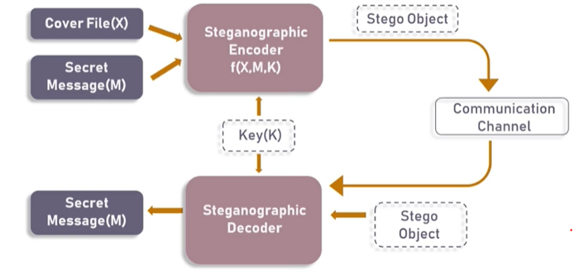
BASIC STEGANOGRAPHIC MODEL

Slide 10
As seen in the above image, both the original image file(X) and secret message (M) that needs to be hidden are fed into a Steganographic encoder as input.
Steganographic Encoder function, f(X,M,K) embeds the secret message into a cover image file by using techniques like least significant bit encoding.
The resulting stego image looks very similar to your cover image file, with no visible changes. This completes encoding.
To retrieve the secret message, stego object is fed into Steganographic Decoder.

Slide 11
EXISTING SYSTEM
TITLE - An analysis of LSB based image
steganography techniques
PUBLISHER - IEEE
This system proposes a method where we hide information in an image file by replacing the last bit of RGB pixel.
But, this procedure doesn’t have high security towards data.

Slide 12

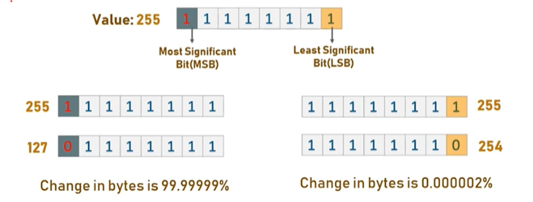

Slide 13
PROPOSED SYSTEM
From the existing system, we modify some methods such as
1)We don’t exactly replace the least bit.
2)Instead we do an reverse of the message bit and embed it in 8th pixel value
This will increase security and can’t be easily decoded by anyone.

Slide 14
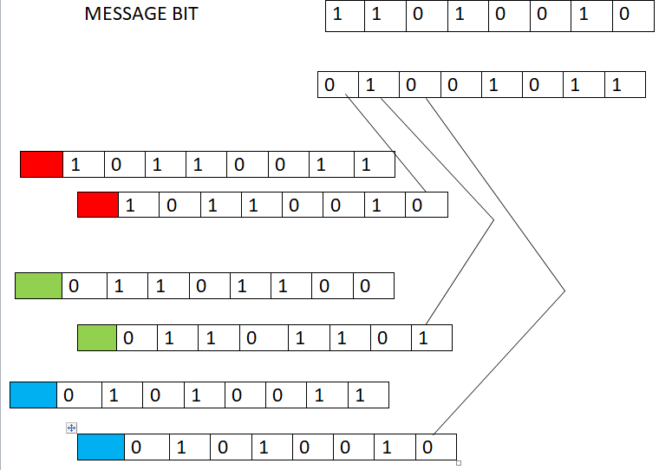

Slide 15
MODULE 1 Converting RGB pixel values to binary
We can describe a digital image as a finite set of digital values, called pixels. Pixels are the smallest individual element of an image, holding values that represent the brightness of a given color at any specific point.
So we can think of an image as a matrix (or a two-dimensional array) of pixels which contains a fixed number of rows and columns.
These pixels will have colors in RGB or RGBA format whose values ranges from 0 to 255.
We convert these values into binary format so that we can insert the message bits in it.

Slide 16
MODULE 2 Convert the message into binary
The message to be converted will be in the form of alphabets.
These alphabets must be converted to binary.
This is done by finding ASCII values(which are in decimal form) for each alphabets.
Then we convert those decimal values into binary

Slide 17
MODULE 3 Encoding the data
The data encoding is done by doing XOR operation with the 7th bit of RGB’s binary value and one of the message bit.
It is then stored in the 8th bit of RGB’s binary value.
The reason we store in the 8th bit is that the color changes of the image will not be a major factor if we replace LSB.

Slide 18
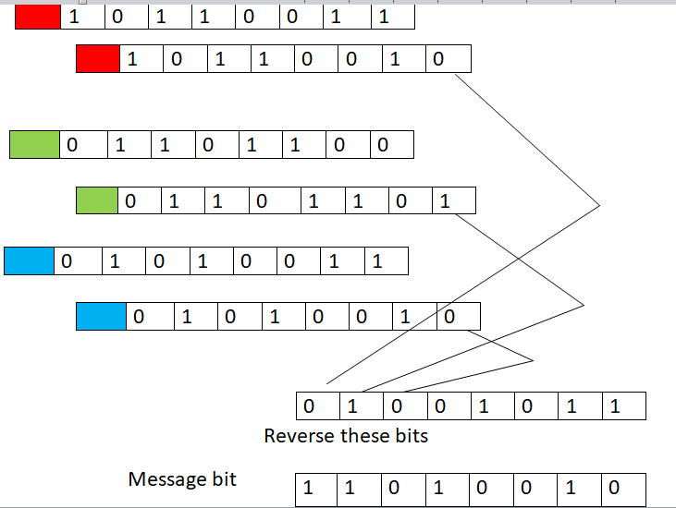
MODULE 4 DECODING THE SECRET MESSAGE

Slide 19
CONCLUSION
We have presented a novel steganographic technique for hiding data in a kind of images. The python source code for hiding the image has been developed. However we can change the encoding and decoding methods in order to ensure more secure transfer of the data and also by creating a password. Theoretic analysis and the computing results show that the steganographic system is secure, the embedding capacity is high and the algorithm is practical.

